Slide 1

Dec 10, 2024
𝛼lphaPoint Capital

Slide 2
𝛼lphaPoint Capital
Fund Overview
Delivering Alpha Beyond Correlation
Introduction
AlphaPoint Capital LP (“AlphaPoint”) is a market-neutral investment firm specializing in statistical arbitrage within the U.S. Energy sector. Our proprietary models identify inefficiencies in cointegrated stock pairs, executing precise mean-reversion opportunities. By leveraging advanced quantitative research and sector-specific expertise, AlphaPoint delivers consistent alpha for investors seeking uncorrelated, risk-adjusted returns. Through disciplined execution and rigorous attention to risk management, AlphaPoint is positioned to deliver consistent results across varying market environments.
Mission Statement
To set a new standard for alpha generation by combining advanced statistical methods, disciplined risk frameworks, and a commitment to innovation. AlphaPoint is built to deliver superior, uncorrelated returns while safeguarding capital and continuously evolving through innovation to meet the changing needs of investors.

Slide 3
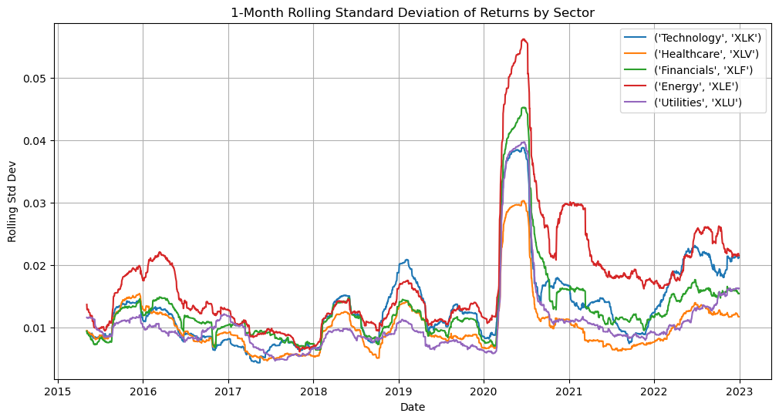
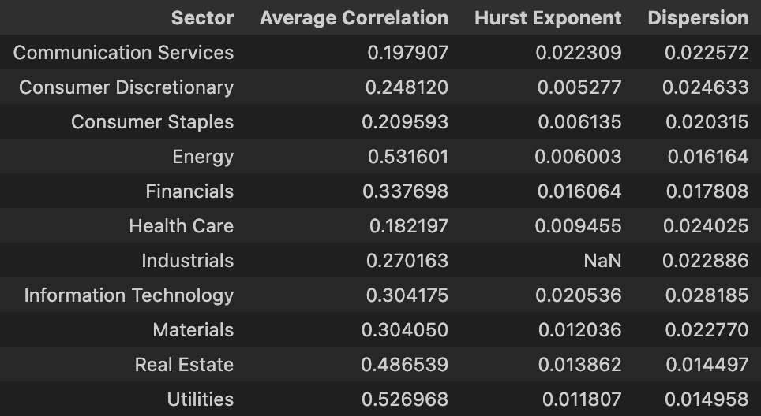
𝛼lphaPoint Capital
Market Focus & Opportunities
Why the Energy Sector?
Strong Fundamentals: A cornerstone of global economic activity, backed by stable demand and advancements in clean and traditional energy.
Dispersion & Correlation: High dispersion and moderate correlation create ideal conditions for mean-reversion strategies.
Volatility Creates Alpha: Elevated sector volatility provides consistent alpha-generation potential, outperforming other sectors.
Statistical Stability: Low Hurst Exponent confirms strong mean-reversion tendencies, perfectly aligning with our approach.
Opportunities for Investors
Precision in Pair Selection: Generate alpha through statistical misalignments in cointegrated stock pairs with a disciplined approach.
Uncorrelated Returns: Achieve risk-adjusted, market-neutral performance independent of broader market trends.
Capital Efficiency: Optimize returns through dynamic rebalancing and robust risk management.
4-Month Rolling Standard Deviation of Returns by Sector
S&P 500 Sector Analysis (2024): Key Metrics for Statistical Arbitrage

Slide 4
𝛼lphaPoint Capital
Strategy Creation
Methodology
Identifying Pairs
Analyze historical price data to compute correlations and identify relationships within the Energy sector.
Conduct cointegration testing to select statistically stable, mean-reverting pairs.
Parameter Optimization
Optimize entry/exit thresholds and rolling window sizes to enhance signal accuracy and adapt to market dynamics.
Apply dollar-volume weighting to ensure consistent exposure across pairs.
Execution Rules
Set stop-loss thresholds to limit risk and preserve capital during extreme spread divergence.
Define rebalancing intervals to minimize costs and maintain portfolio alignment.
Start
End
Data Input
Correlation Analysis
Cointegration Testing
Parameter Optimization
Execution Rules
Portfolio Construction
Investment flowchart

Slide 5

𝛼lphaPoint Capital
Our Advantage
Liquidity: Portfolio consists of the most highly-traded U.S. energy in the SP500, allowing us to greatly expand our trading capacity.
Flexibility: Due to our high liquidity, our withdrawal lock-ups are much more flexible, especially compared to peers.
Agility: As a small team, we are nimble and able to adapt quickly to changing market conditions, seizing opportunities as they arise. We prioritize creative investment approaches and concentrate on high-conviction ideas to deliver value.
High-Touch Approach: Our compact size allows for a more personalized relationship with investors, ensuring direct communication and tailored attention to client needs. Each investor is a priority, and we are deeply committed to building long-term, trusted partnerships.
Talent-Driven: Our team comprises of highly ambitious professionals with exceptional backgrounds in finance and mathematics.

Slide 6
𝛼lphaPoint Capital
Management & Execution
Precision-driven execution for market-neutral excellence
Active Monitoring and Rebalancing
Daily monitoring of all trade signals ensures precision in capturing market inefficiencies.
Monthly rebalancing adjusts portfolio weights and updates cointegrated pairs to reflect changing dynamics.
Efficient Execution Framework
Trades executed exclusively in high-volume Energy sector stocks to minimize slippage and transaction costs.
Average transaction cost of 0.065% per stock/transaction, based on NYSE benchmarks for cost efficiency.
Portfolio Scope and Scale
Tracking and trading 20+ carefully selected tickers, ensuring statistical stability and market liquidity.
Risk Management Framework
Carefully calibrated stop-loss orders cap downside risk and safeguard capital
Dynamic optimization of stop-loss thresholds, ranging from 1.65 to 3.2 (incremented by 0.5), ensures a strategic balance between risk mitigation and return maximization.
Strategic Leverage Utilization
Leveraging our capital at a 6:1 ratio, aligned with FINRA’s 15-20% margin requirements for market-neutral equity portfolios, we amplify return potential while adhering to rigorous risk management protocols. This disciplined approach ensures efficient capital deployment without compromising portfolio integrity.

Slide 7
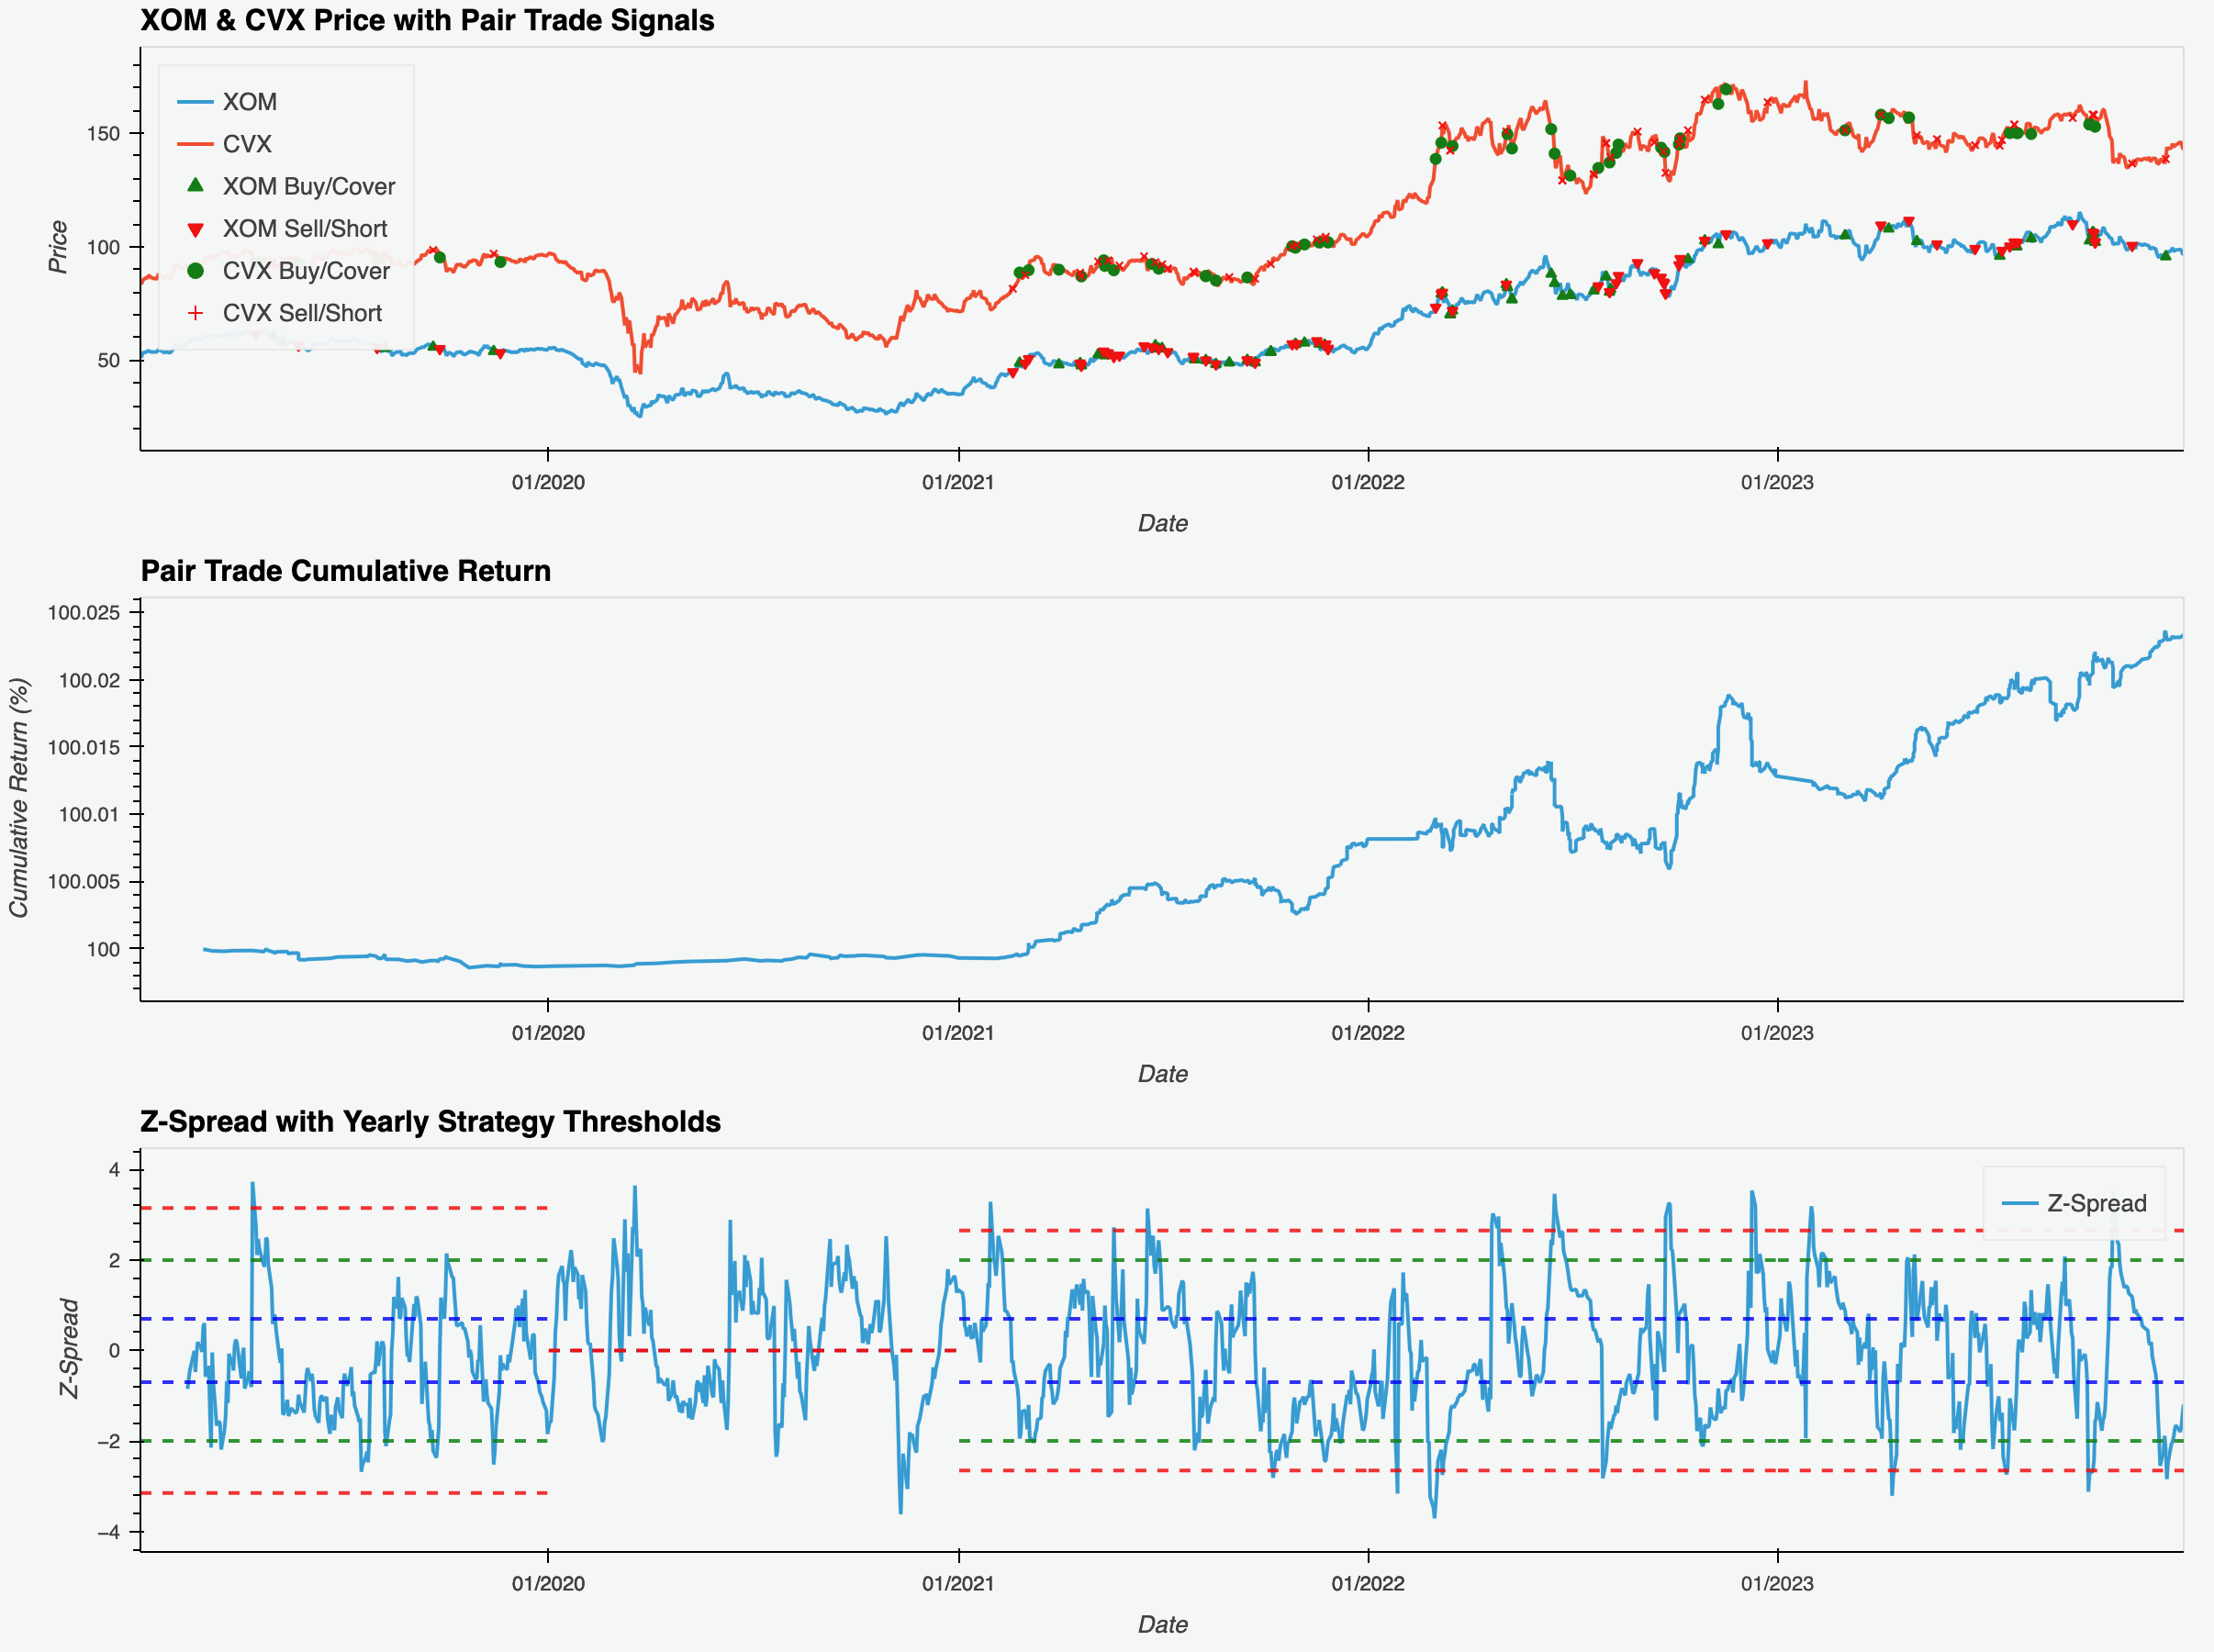
𝛼lphaPoint Capital
Trade Lifecycle Example

Slide 8
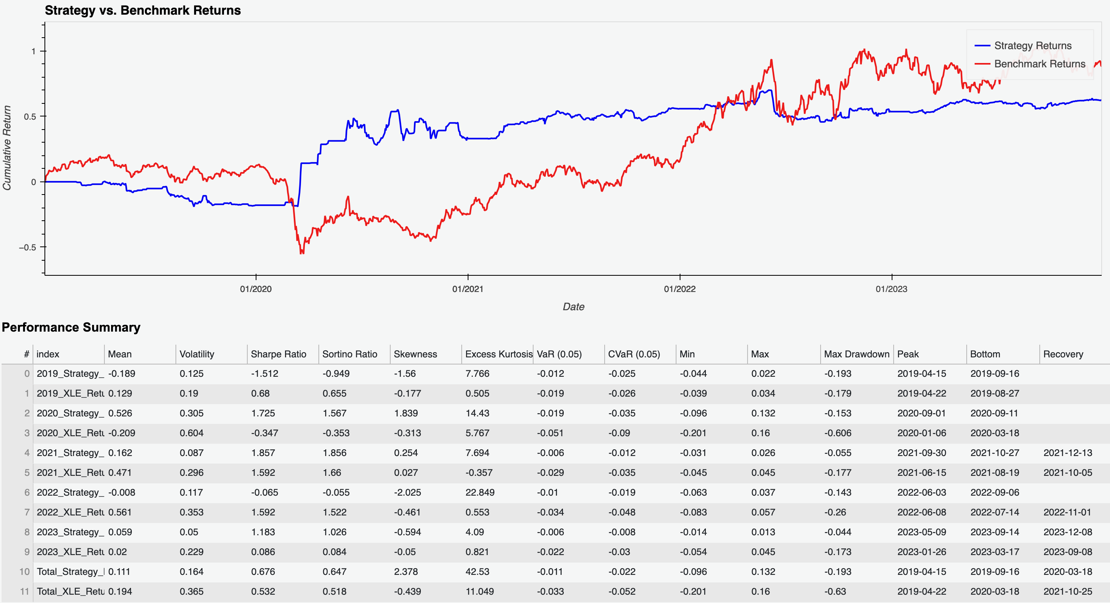
𝛼lphaPoint Capital
Strategy Performance

Slide 9
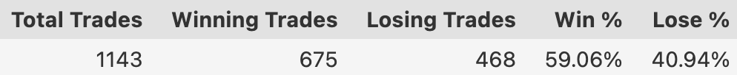
𝛼lphaPoint Capital
Strategy Performance
Trade performance summary
Resilience in Volatile Markets: Delivered 52.6% return in 2020 vs. benchmark’s -20.9%, capitalizing on market downturns with stability.
Superior Risk Efficiency: Sharpe Ratio of 0.68 (vs. 0.53 benchmark) and lower volatility (16% vs. 37%) reflect disciplined risk management.
Drawdown Control: Maximum drawdown of -19.3% vs. benchmark’s -63%, prioritizing capital preservation for risk-averse investors.
Limited Upside in Bull Markets: Underperformed during rallies, with a -0.8% return in 2022 vs. benchmark’s 56.1%, signaling refinement opportunities for capturing momentum.

Slide 10
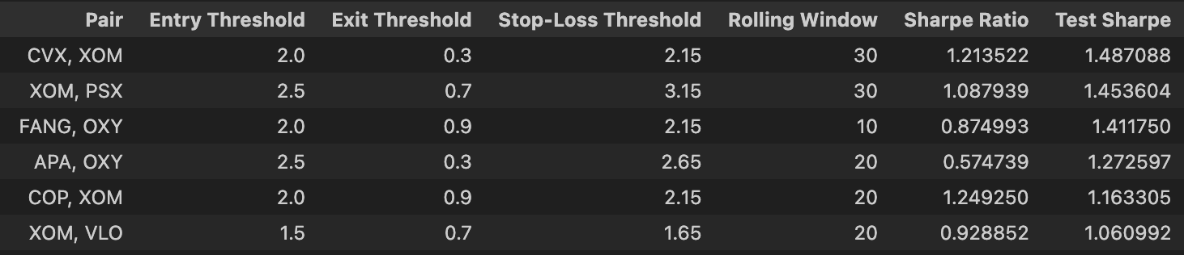
𝛼lphaPoint Capital
Backtesting Results
Methodology – Walk-Forward Analysis
Training Period: 4 years (e.g. 2019–2022) used to calibrate pair selection, entry/exit thresholds, and stop-loss optimization.
Testing Period: 1 year (e.g. 2023) used to validate the strategy’s performance on data outside the training set.
Optimized Pair Parameters and Performance Metrics

Slide 11
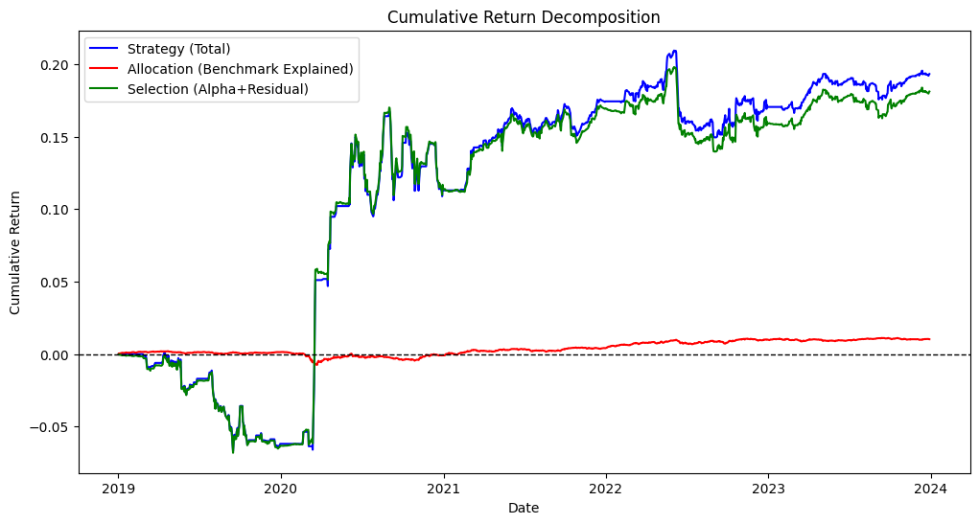
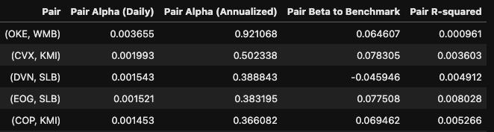
𝛼lphaPoint Capital
Performance Attribution & Return Decomposition
Pair-level attribution
Market-Neutral Allocation: Negligible allocation effect confirms the strategy's independence from sector or market-wide movements.
Selection-Driven Returns: Strategy performance overwhelmingly driven by selection effects, showcasing the success of pair selection and entry/exit timing.
Alpha Generation: Idiosyncratic stock-pair trades and mean-reversion profits dominate returns, with residuals capturing reversion dynamics beyond benchmark explanations.
Low Benchmark Dependency: Extremely small R-squared values at the pair level highlight minimal reliance on benchmark-driven returns.

Slide 12
𝛼lphaPoint Capital
Strategic Summary
Core Strategy
A market-neutral approach leveraging statistical arbitrage in the U.S. energy sector.
Focused on identifying inefficiencies in cointegrated stock pairs for mean-reversion opportunities.
Methodology Highlights
Pair Selection: Advanced cointegration analysis to identify stable, mean-reverting pairs.
Parameter Optimization: Adaptive thresholds and rebalancing to ensure precision and resilience.
Execution Excellence: High-frequency execution in liquid markets minimizes costs and slippage.
Performance Highlights
Proven resilience in volatile markets, with superior Sharpe ratios and controlled drawdowns.
Demonstrated low benchmark dependency and high selection-driven returns.
Investor Value
Delivering consistent alpha through uncorrelated, risk-adjusted strategies.
Combining sector expertise, innovation, and disciplined execution for long-term success.

Slide 13

Meet the Team
Zak: DEI Specialist
Riccardo: Head of HR
Jesse: Water Cooler Repairman
Joey: Head of DEI
Nick: ESG Intern

